Slide 1

BookBoxBook
team GoNaMi
Hoyun Ko
Yuseon Nam
Seungyun Lee
Notes:
여기서 설명 간단히 한 줄 정도 할깡..?

Slide 2
Index
01
Progress
(What we’ve done during last week)
02
Further Schedule
03
Q&A

Slide 3
1
What we’ve done

Slide 4


Progress
BBB
Apppication
BookBoxBook
BookBox

Slide 5


Application - Done
1. Database Reconstruction
B.B.B
2. Show Cover Image
3. Book Search
4. Buy List

Slide 6

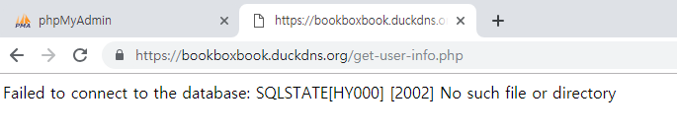
1. Database Reconstruction
: Realize there are some problems with Server or Database

Slide 7

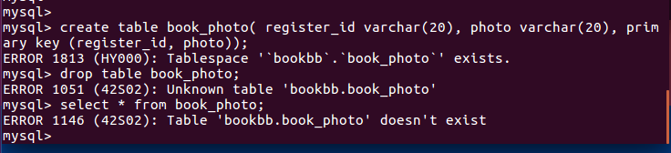
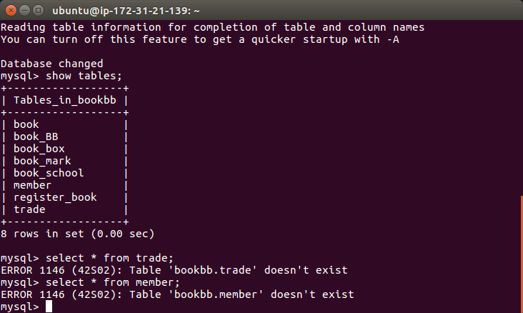
1. Database Reconstruction
<Problems with DB>
ⓐ
Create
Exist
Delete
Don’t Exist
ⓑ
Table: member, trade
Don’t Exist?
Notes:
그래서 이거저거 시도해보다가 결국 다 날리고 다시 만들었다

Slide 8

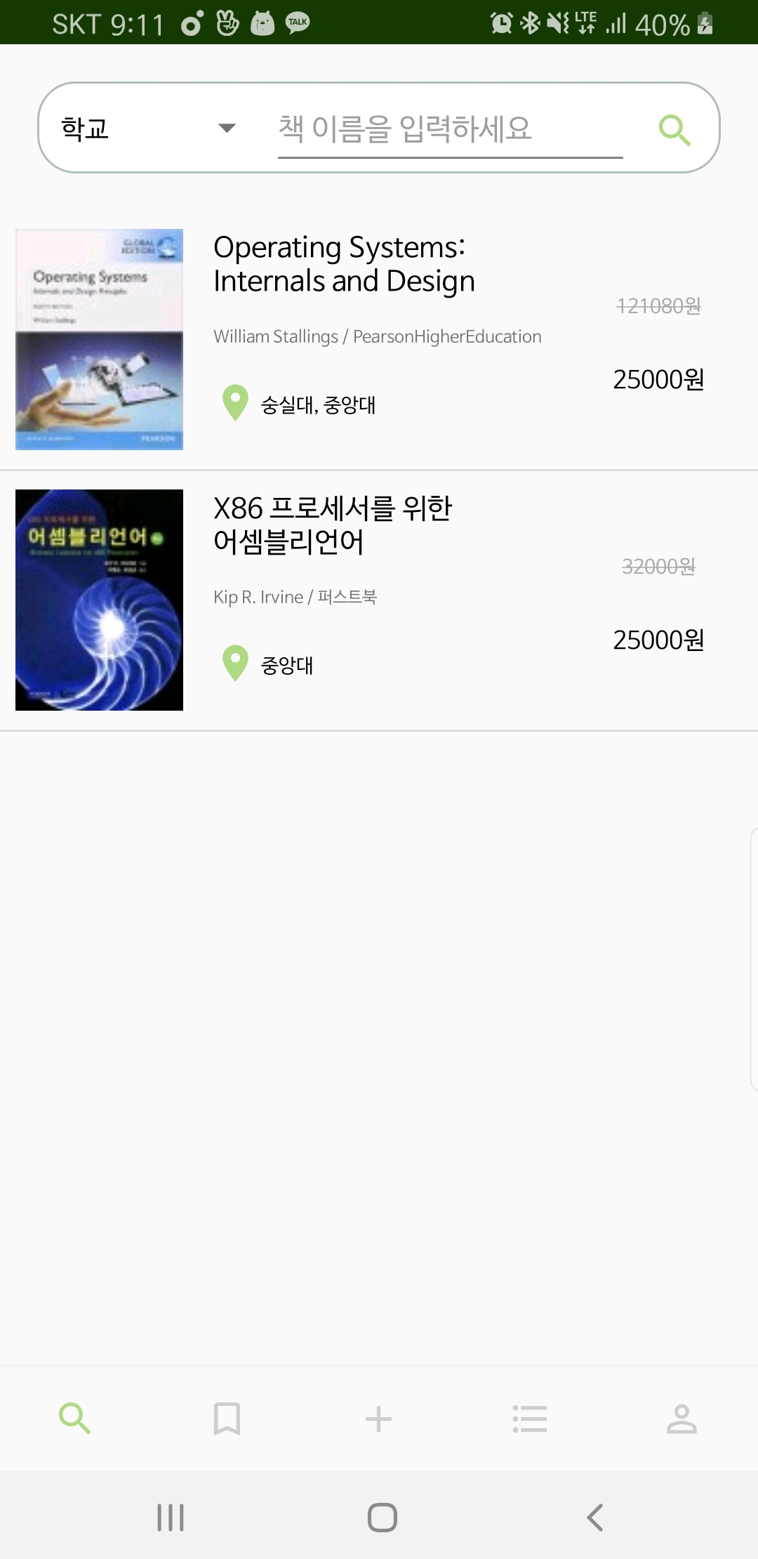

2. Show Cover Image
Get images using…
Thread
Glider
: have troubles
→ bring wrong or overlapped image

Slide 9
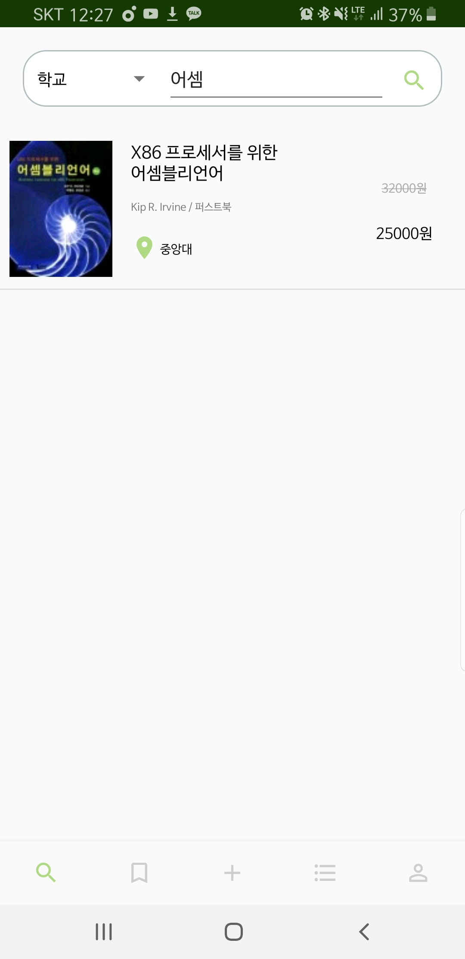
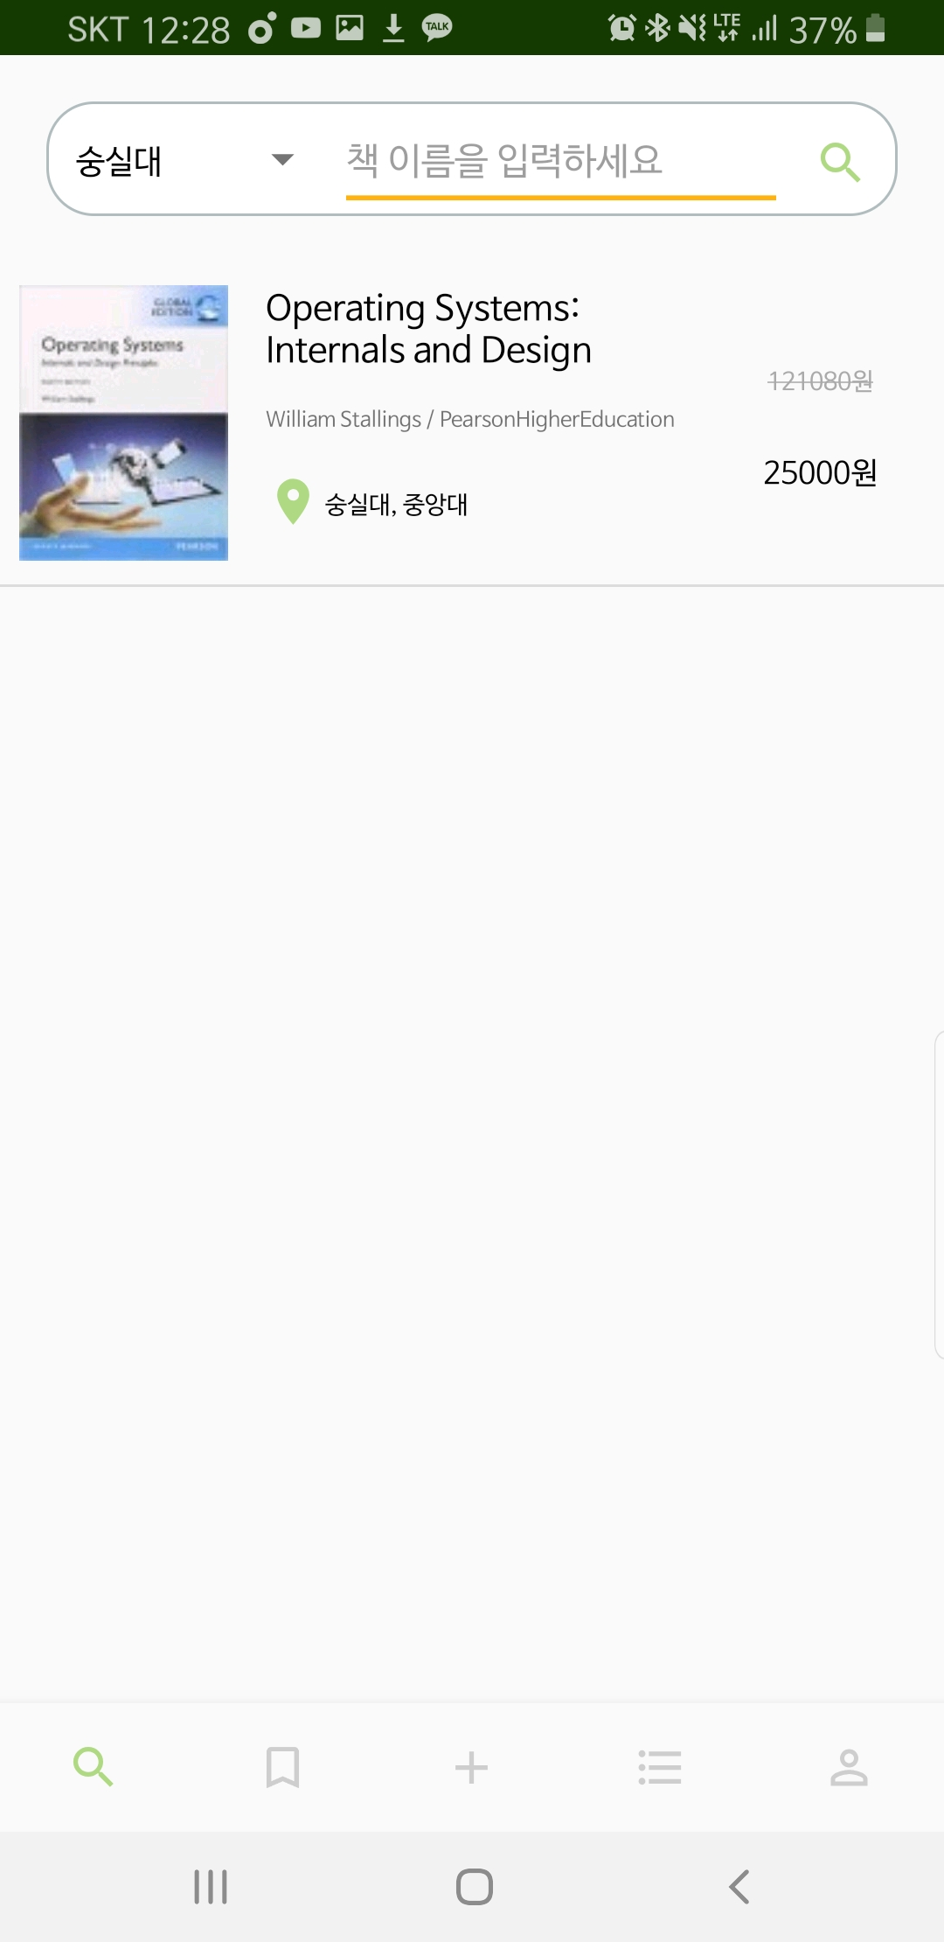
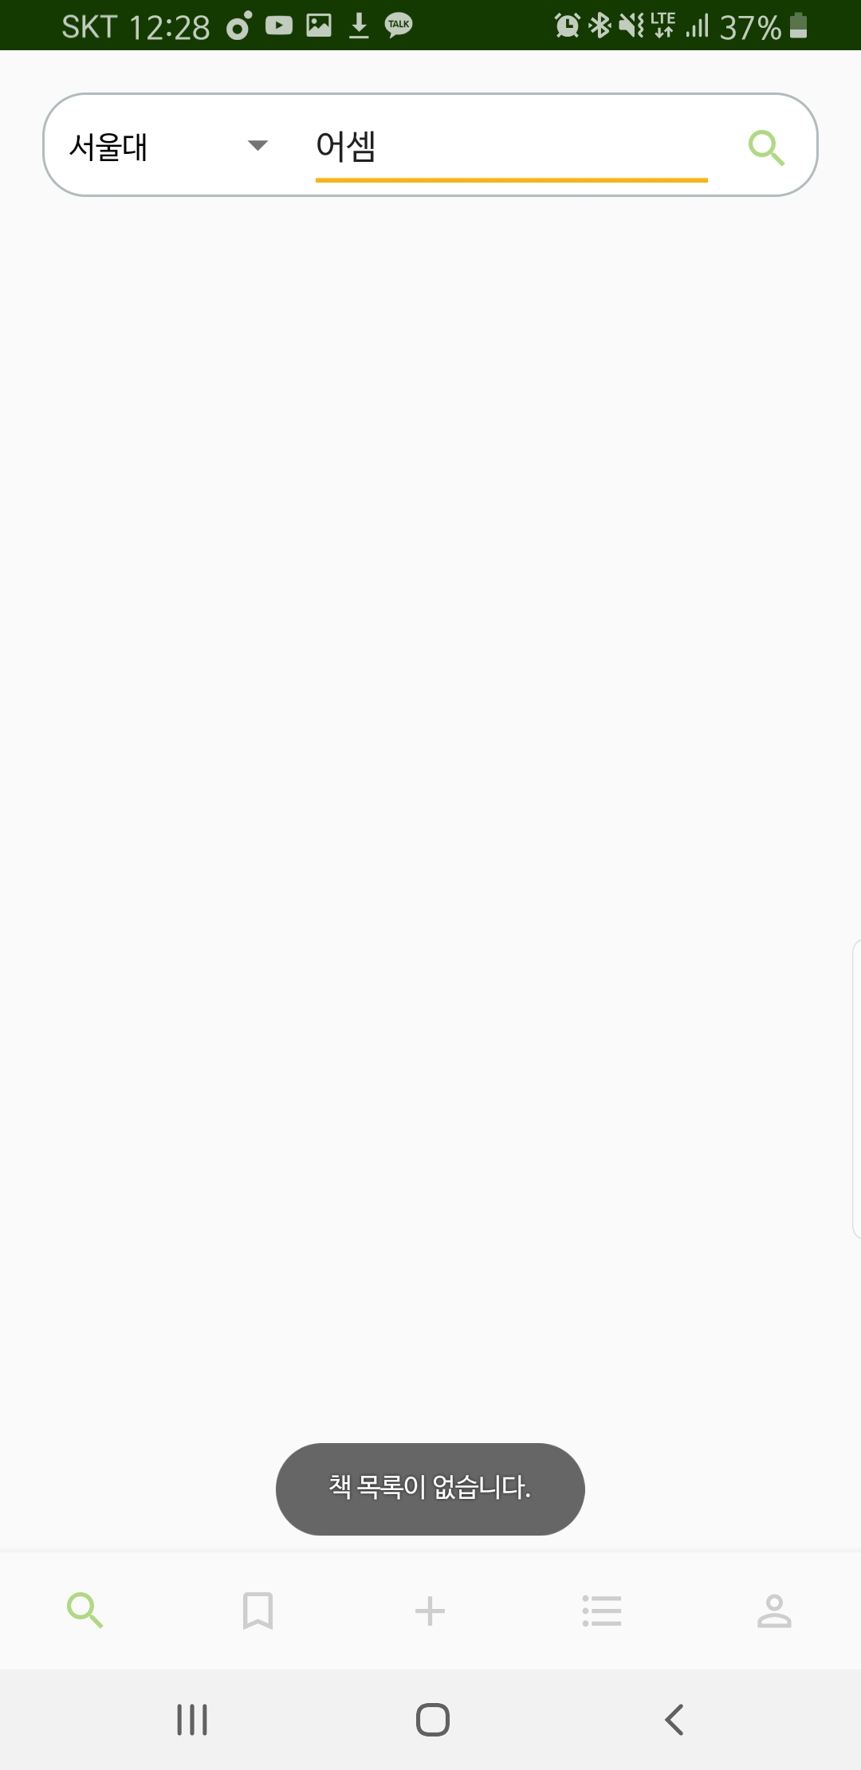
3. Book Search
Search based on…
Book Name
School Name
No book available in SNU

Slide 10
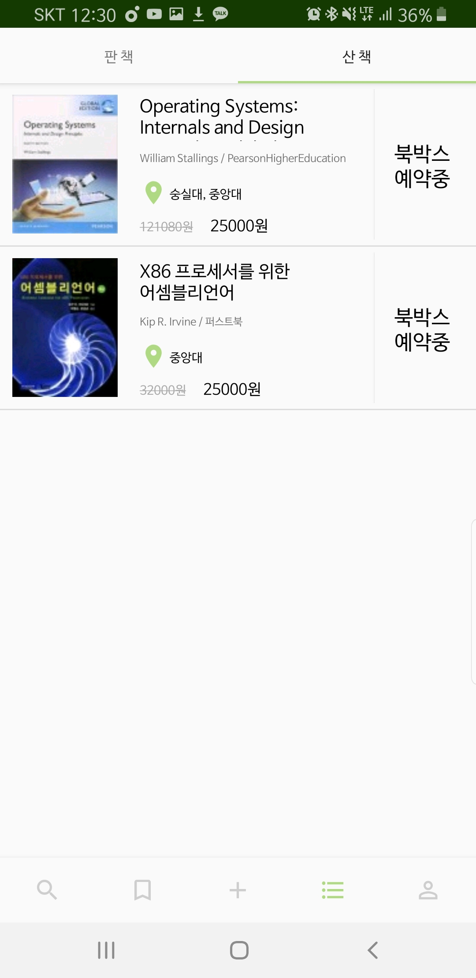
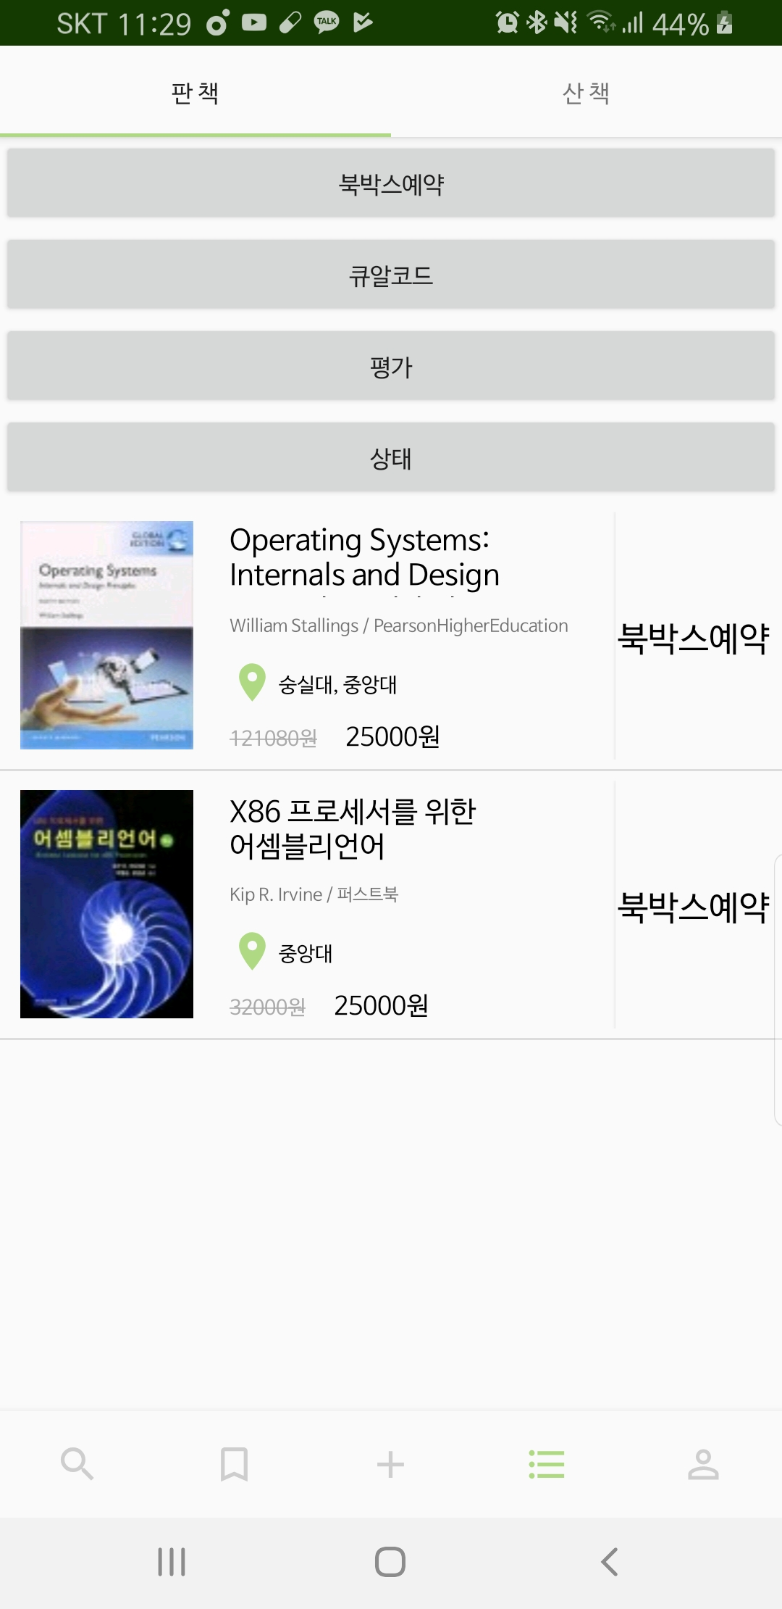
4. Buy List
◀ Buy List
Sell List ▶
+) We can show users the actual transaction state
Notes:
저번주에는 판 책 리스트만 가능했는데 이제 산 책 리스트까지!
+) 추가로 저번에는 상태표시 못했다고 했는데 이제 “실제”거래상태 표시가능(물론 아직 다한 건 아니라 일부 상태만 표시)

Slide 11
Application – On Progress
1. Payment
B.B.B
2. Transaction state
- Buy
- Reserve Book Box

Slide 12
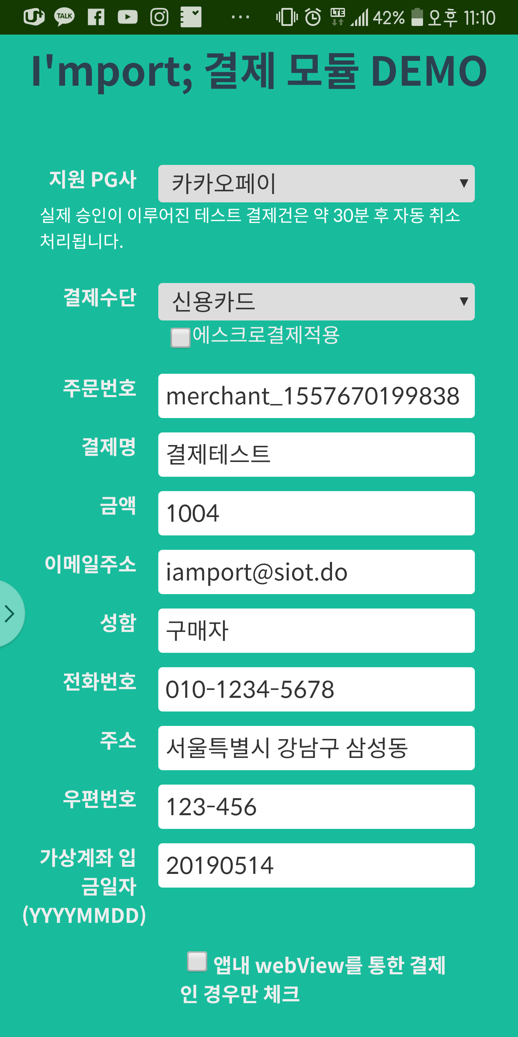
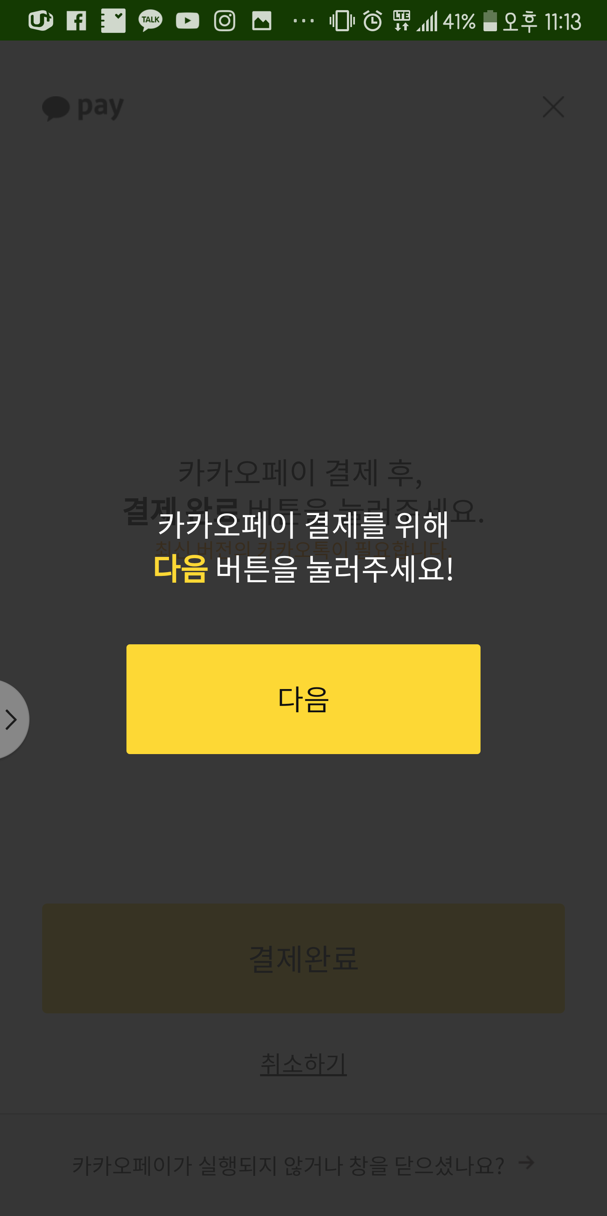
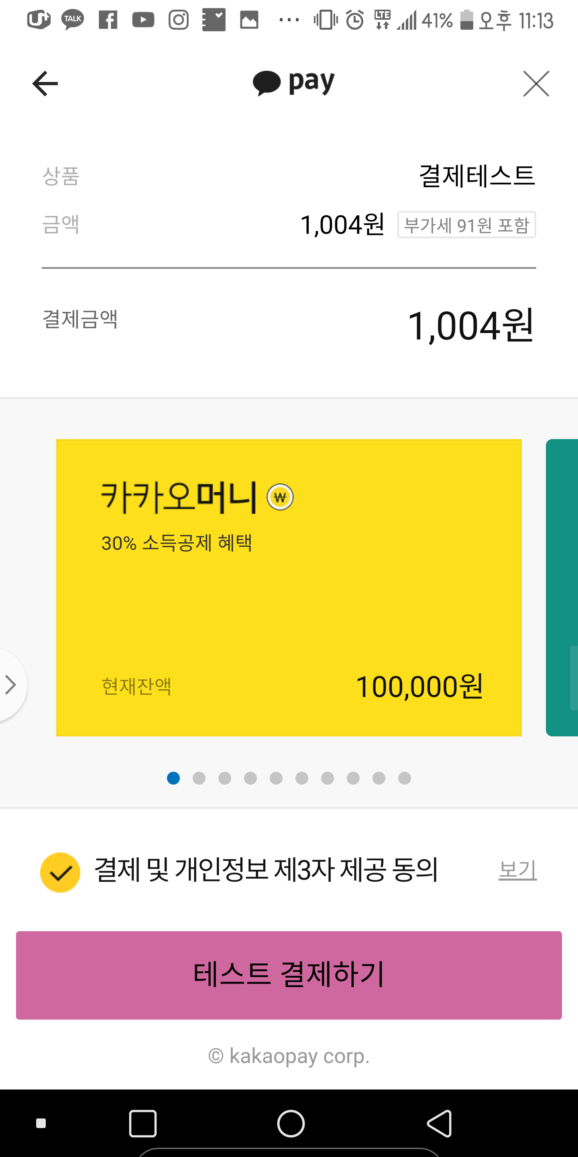
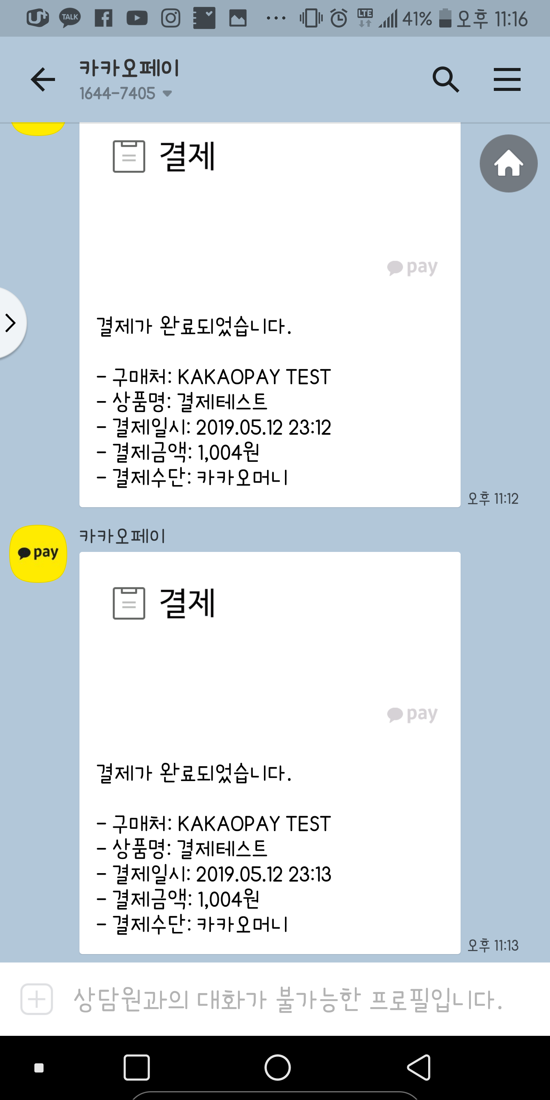
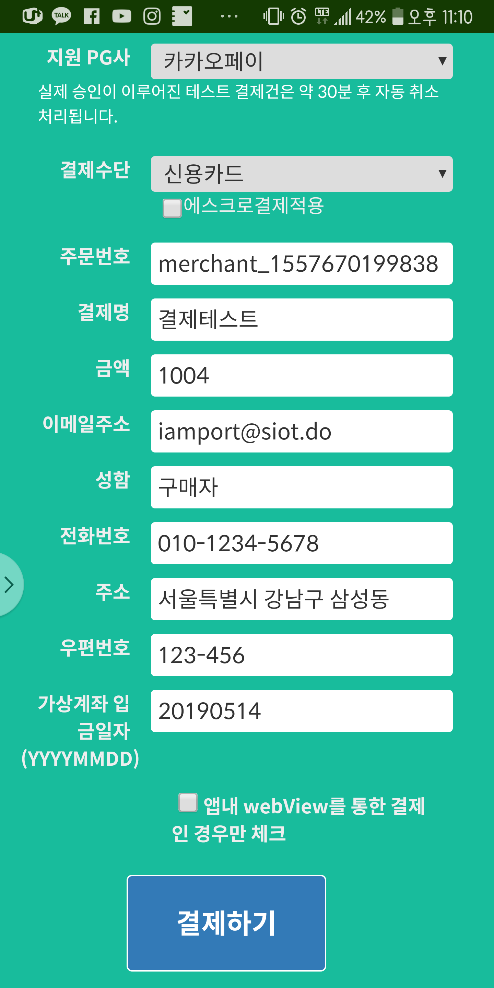
1. Payment
- Through API ‘I’M PORT’
2
Payment Complete!
3
1

Slide 13
2. Transaction state
Value | Transaction state | Seller | Buyer
0 | Books are not sold yet | Books are not sold yet | .
1 | Buyer bought the book But, seller didn’t make a reservation yet | Please make a reservation | Seller didn’t make a reservation yet
2 | The day seller put the book | Please put a book | Seller didn’t put the book yet
3 | Seller put the book | Buyer didn’t take her/his book yet | Please take your book
4 | Before confirm the transaction |  | Please confirm your transaction
5 | Transaction Comfirmed - Before transfer money | Please type your bank account | Transaction confirmed Please rate your purchase
6 | Transaction Comfirmed - After transfer money | Transaction confirmed | Transaction confirmed
7 | Report a problem | Oops..my book is reported… | Proceeding the report
8 | Cancellation approved | Transaction canceled | Transaction canceled

Slide 14
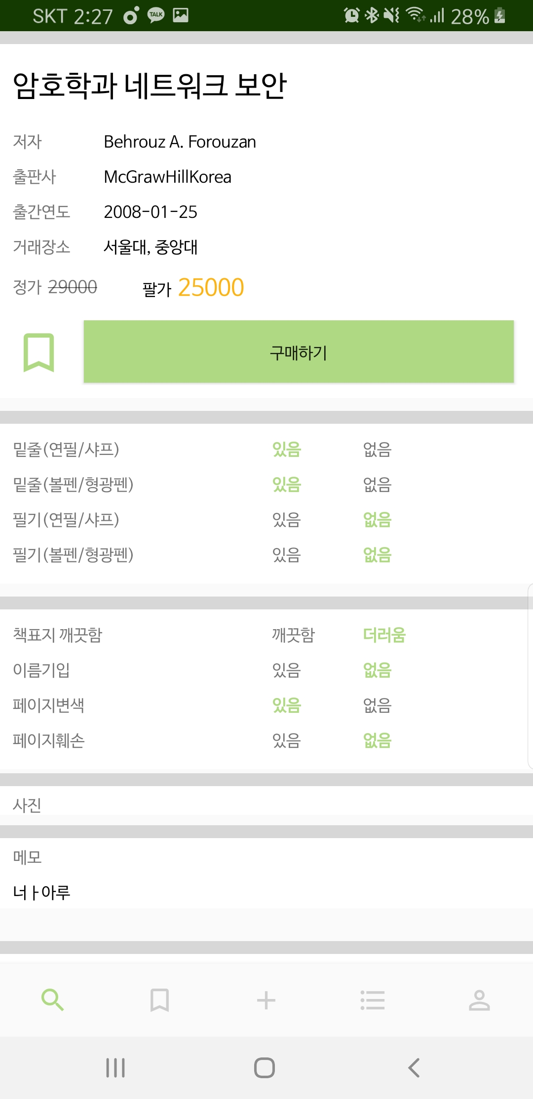
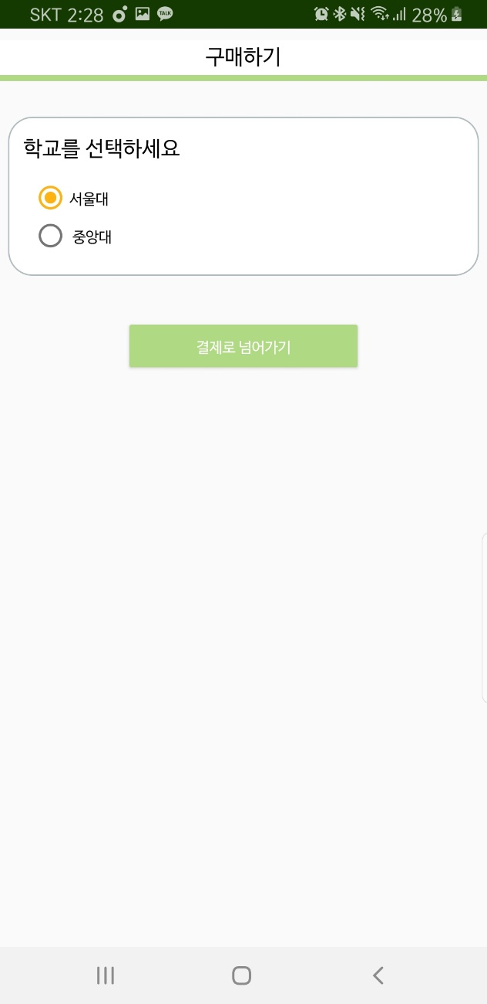
2. Transaction state – Buy (0->1)
Buyer

Slide 15
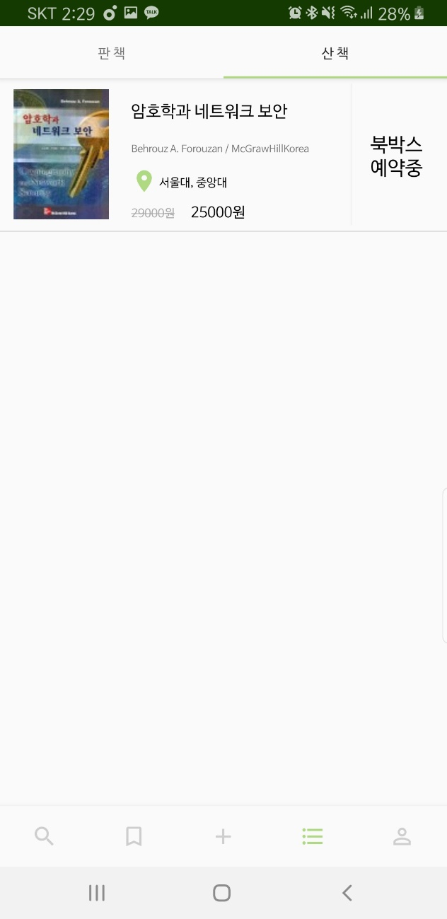
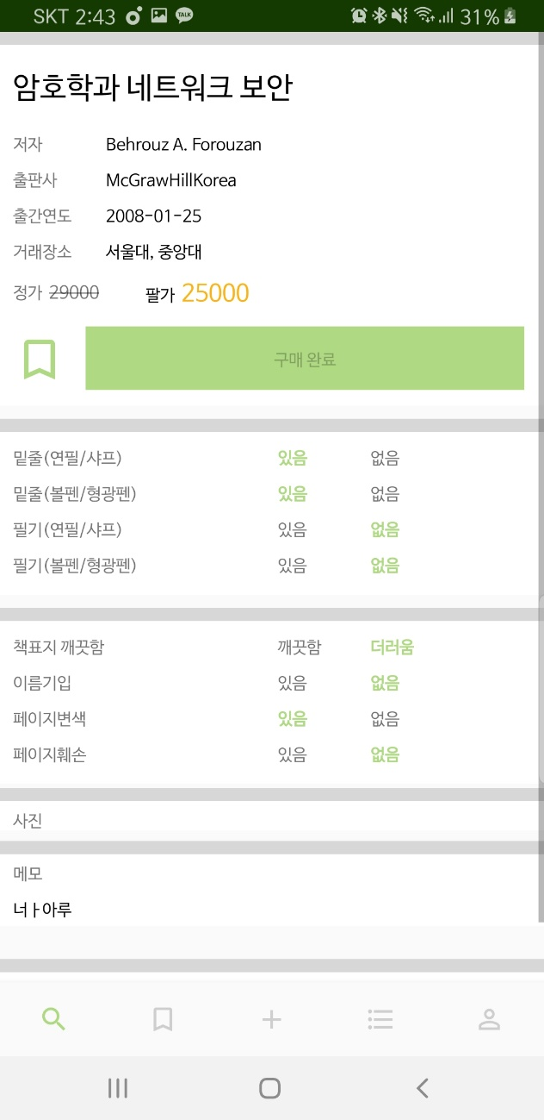
2. Transaction state – Buy (0->1)
Buyer

Slide 16
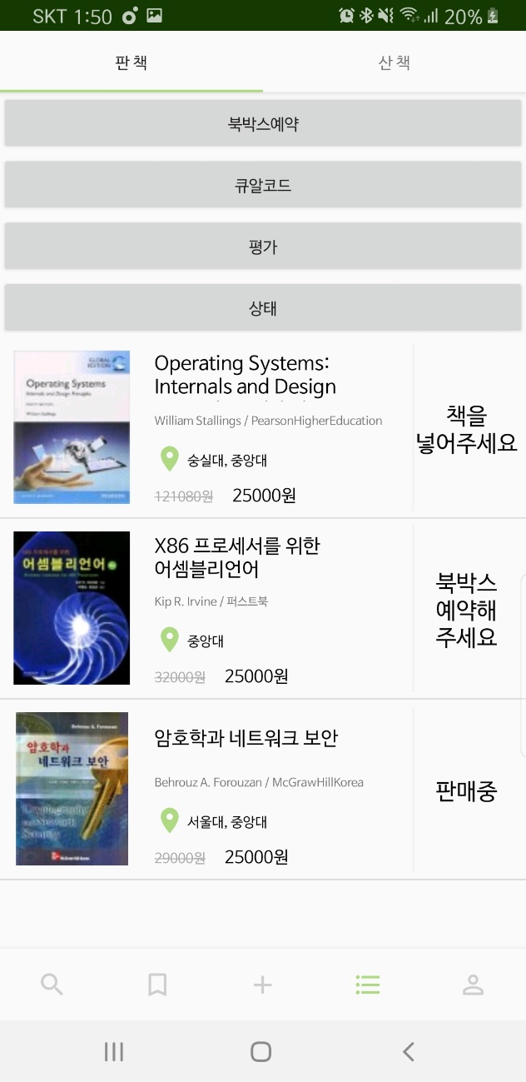
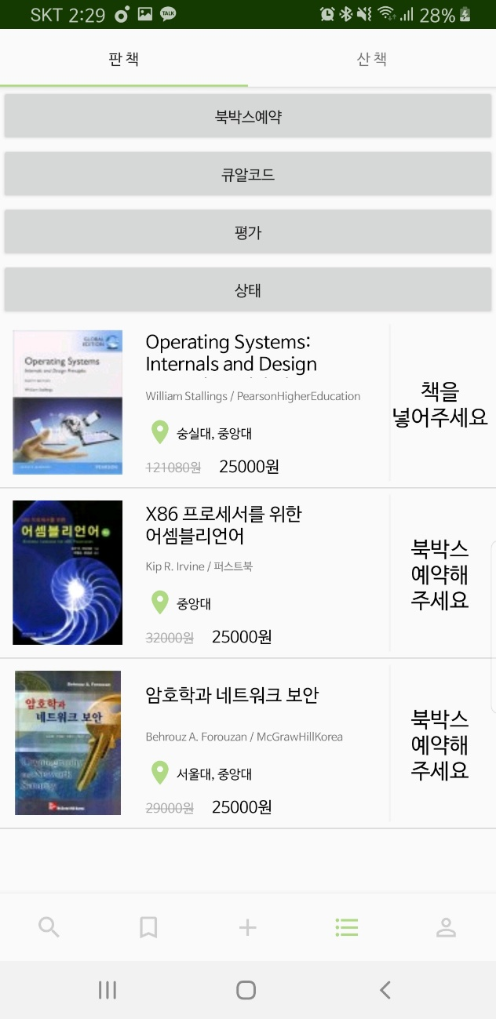
2. Transaction state – Buy (0->1)
Seller

Slide 17
2. Transaction state – Reserve Book Box (1->2)
Seller
Click!

Slide 18
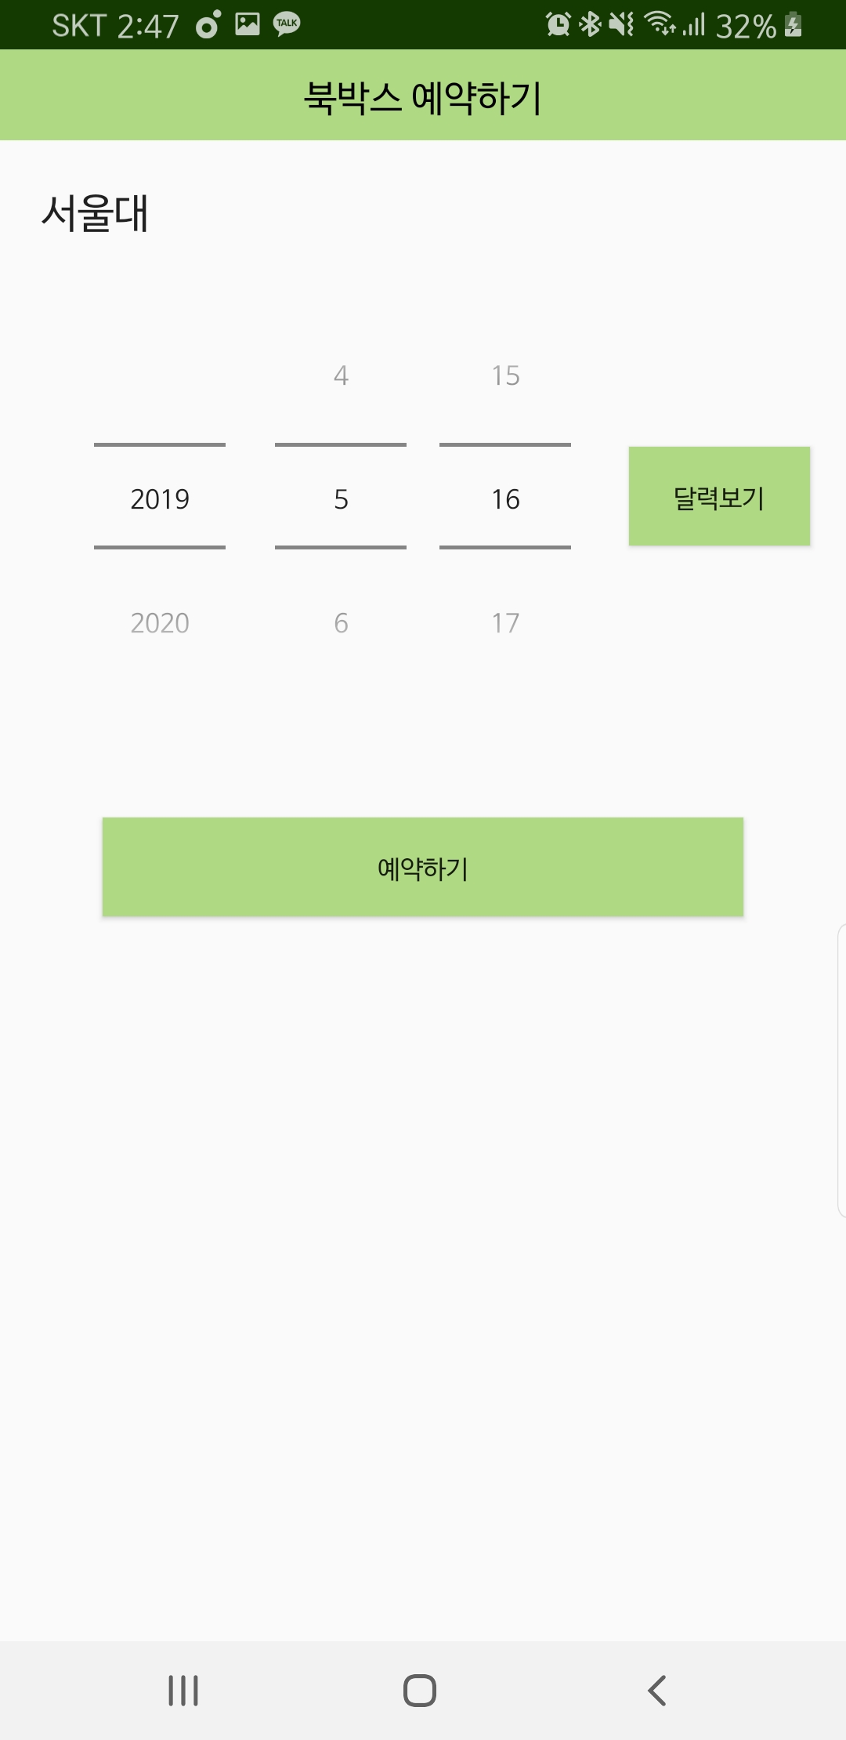
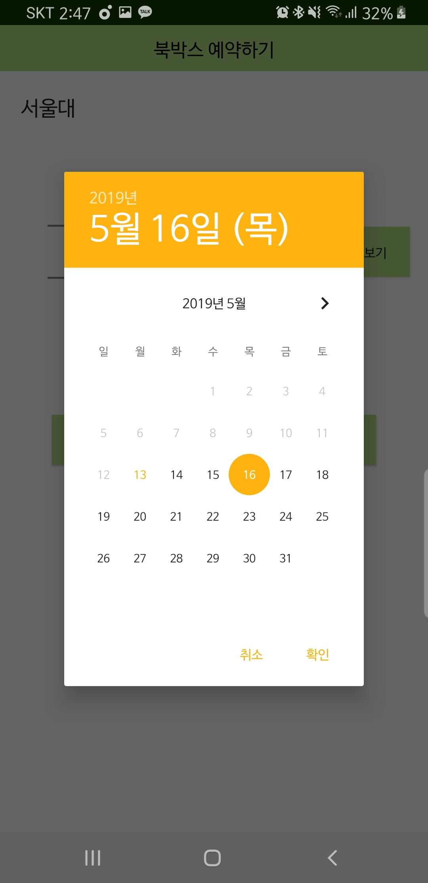
2. Transaction state – Reserve Book Box (1->2)
Seller

Slide 19
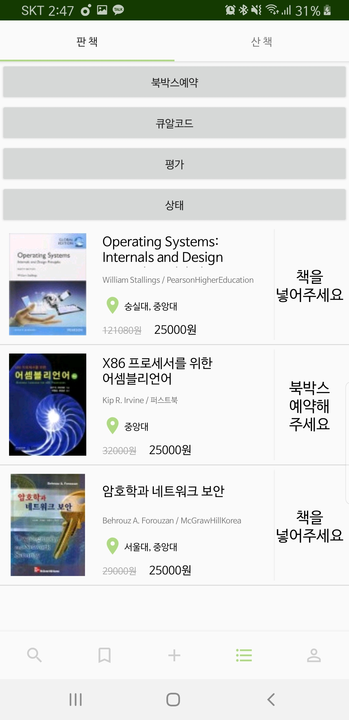
2. Transaction state – Reserve Book Box (1->2)
Seller

Slide 20

2. Transaction state – Reserve Book Box (1->2)
Buyer

Slide 21

BookBox (Hardware)
Locker
-servo motor
2. QR code Recognition
3. Convert
Hangul and English

Slide 22
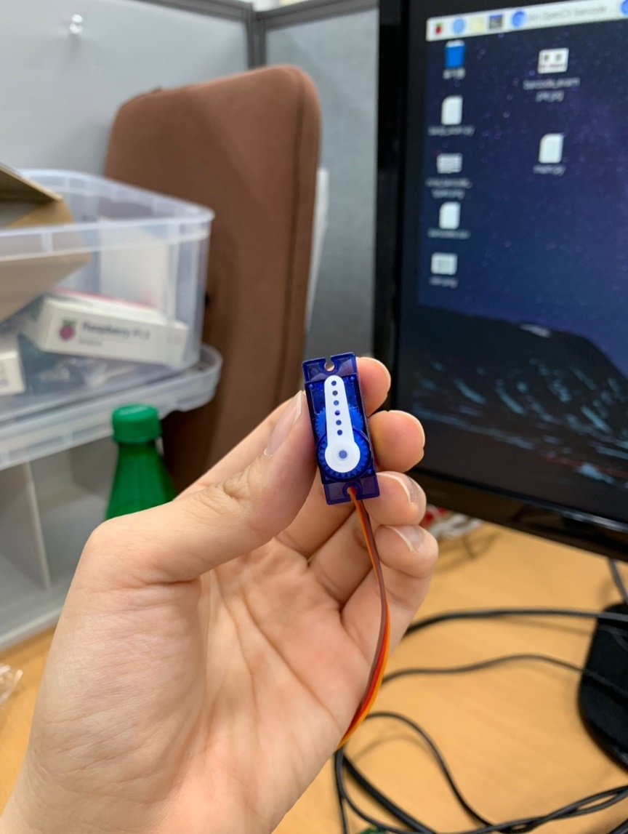
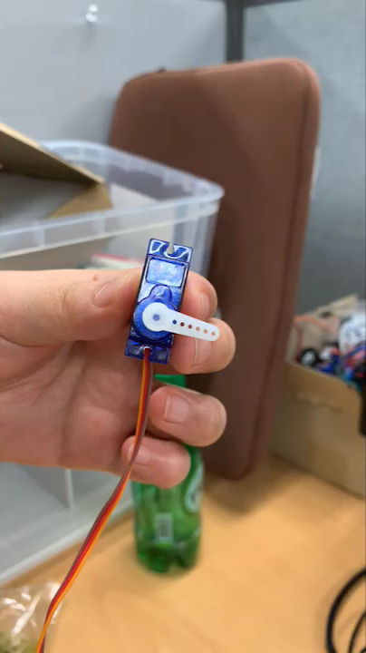
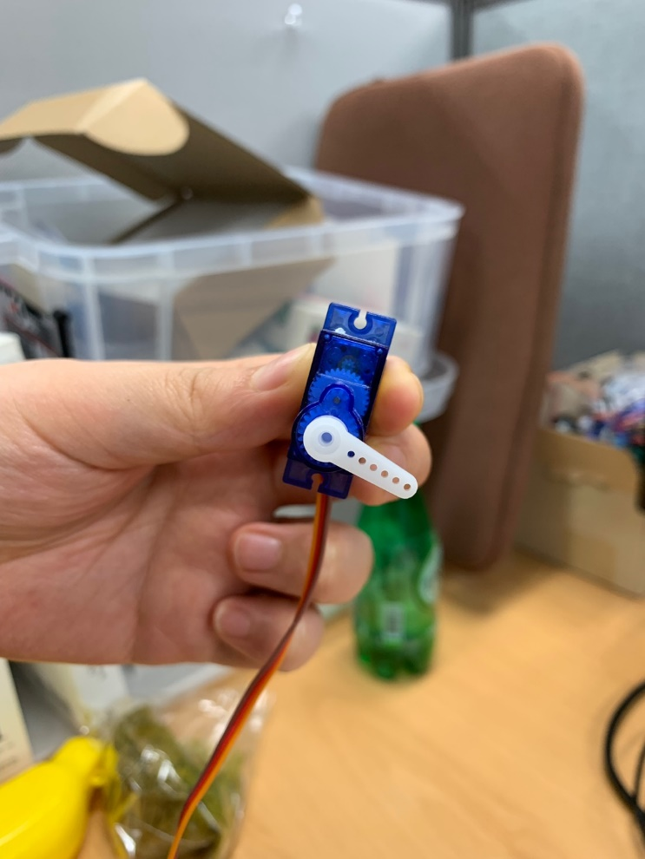
1. Locker
open
closed
Notes:
동영상은 애니메이션 넣었다

Slide 23
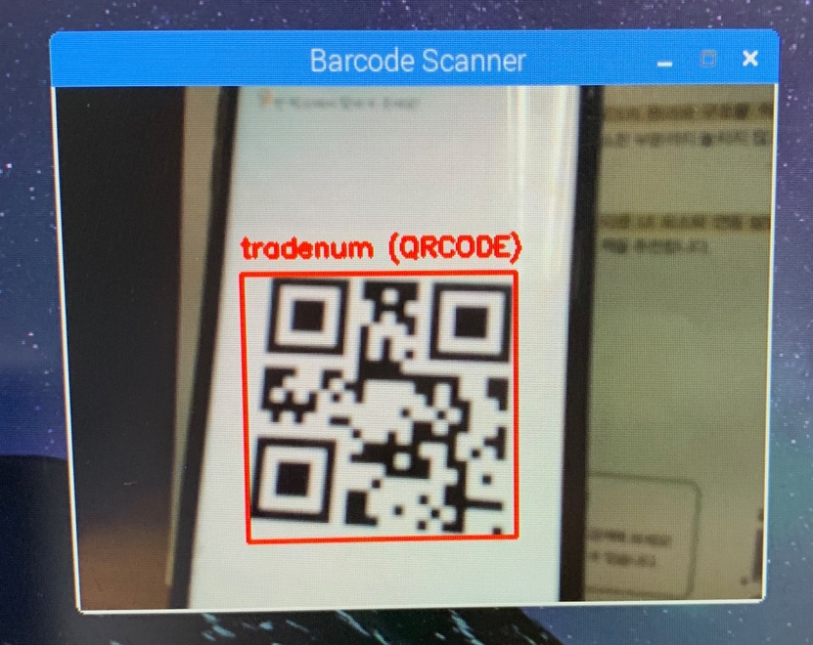
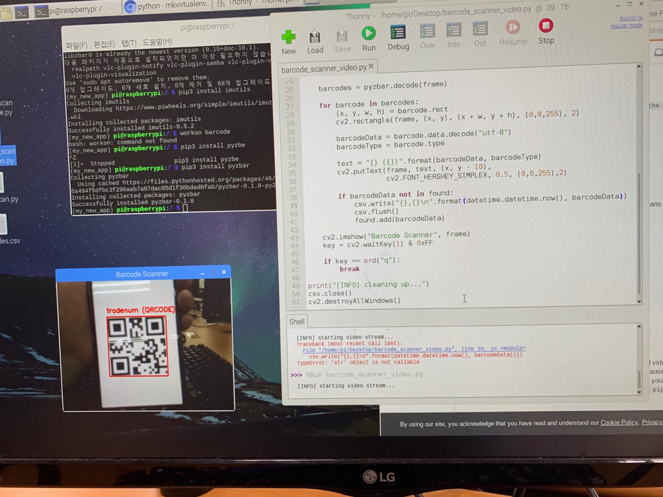
2. QR code Recognition
Successfully recognize QRcode!
Notes:
우리가 생성한 큐알 인식했다
-빨간 하이라이트 애니메이션으로 하였당

Slide 24
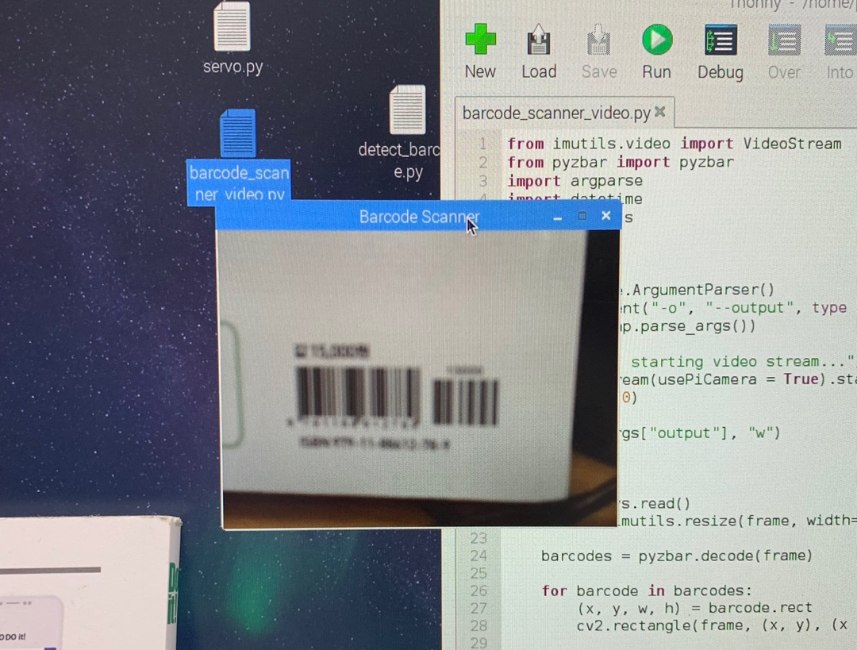
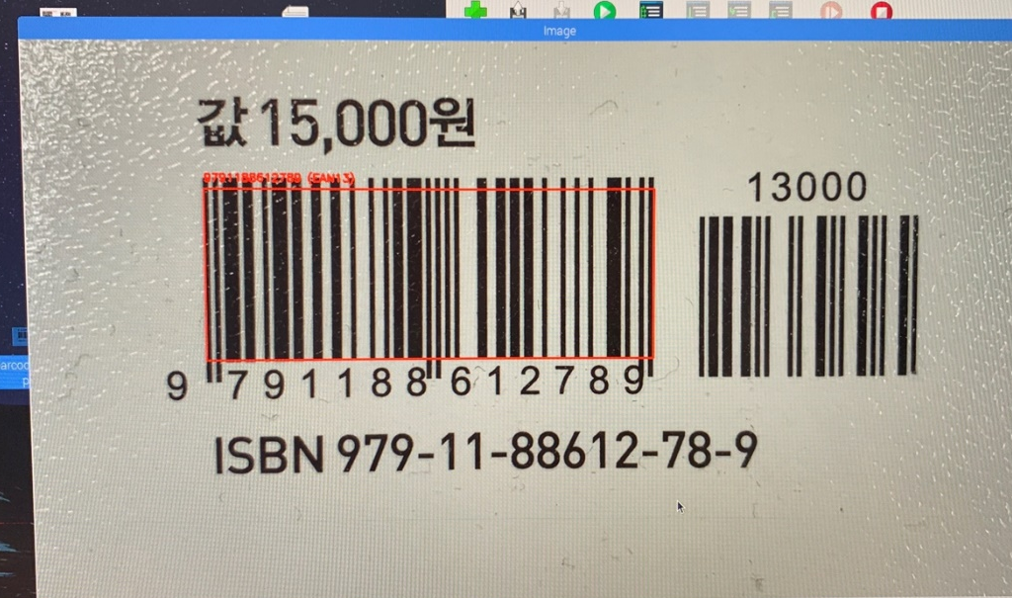
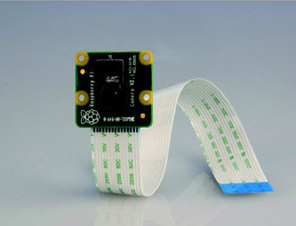
2. QR code Recognition
However…
▼ raspberry pi camera module
Cannot recognize Barcode
Can recognize Barcode
due to low camera quality
when we put the image of barcode
Notes:
우리가 쓰는 라즈베리파이 카메라모듈이 화질이 안좋아서 구분을 잘 못한다 -> 바코드 인식x
애니메이션!-> 같은 방식의 알고리즘: 이미지를 직접 넣었을 때는 인식함! (카메라 문제임을 확인하였다)

Slide 25
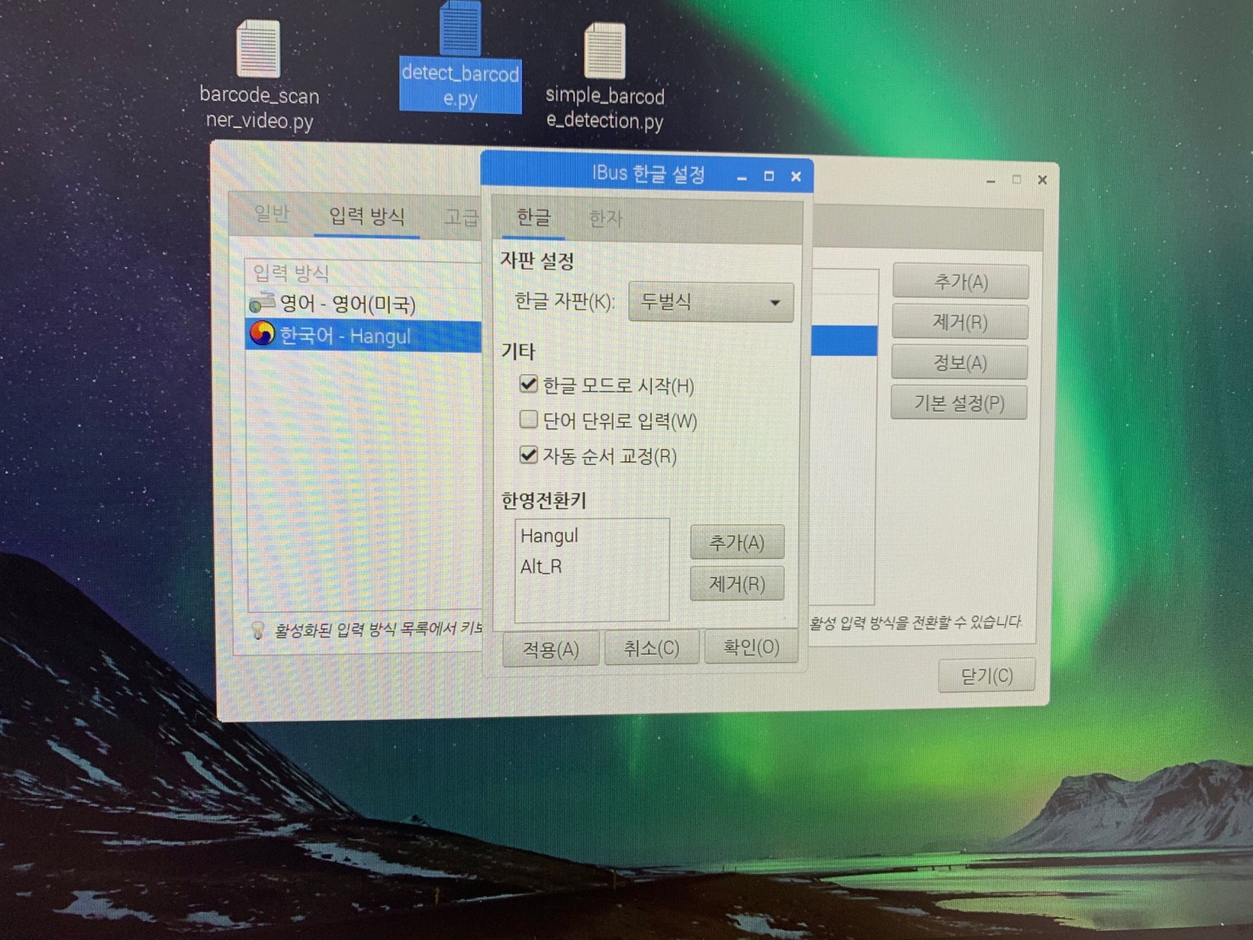
3. Convert Hangul and English
- Fail to write Hangul in Raspberry Pi
Changing setting didn’t work…
Notes:
Ibus(아이버스)로 한글을 설치한 거라서 ibus 설정에서 전환키 설정을 해줬는데 이상하게 계속 안된다ㅠㅠ
Ibus 문제인가해서 fcitx도 설치해서 해봤는데 안된다.
우선은 영어로 하기로하고 먼저 중요한 것부터 하기로! (시간이 있다면 또 시도해보겠다)

Slide 26
2
Further Schedule

Slide 27
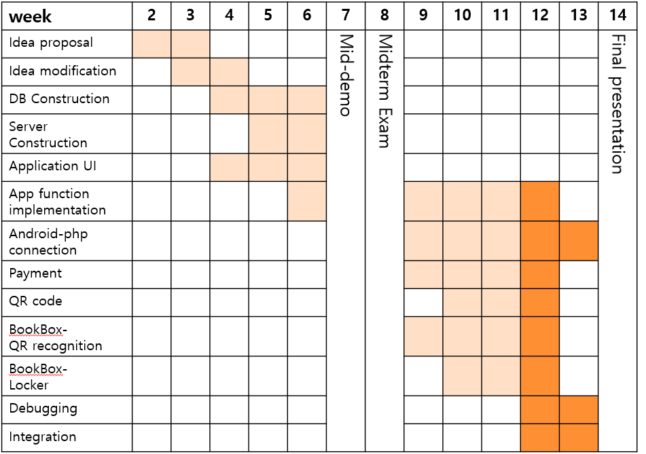
Last week(done)

Slide 28
This week(to do)

Slide 29
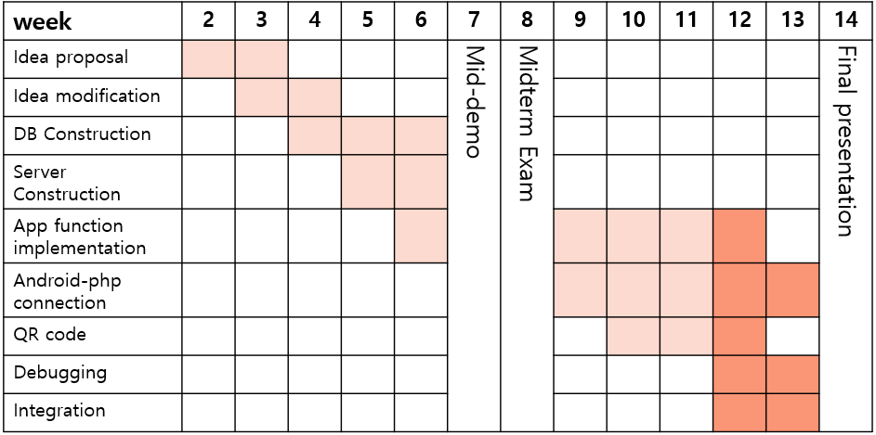
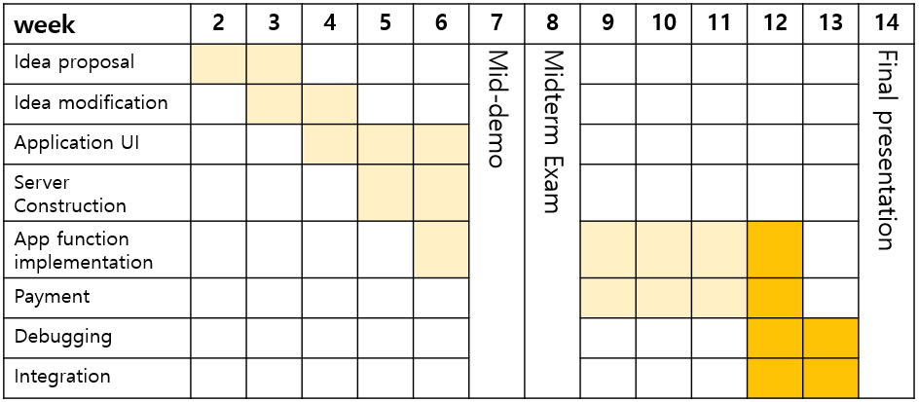
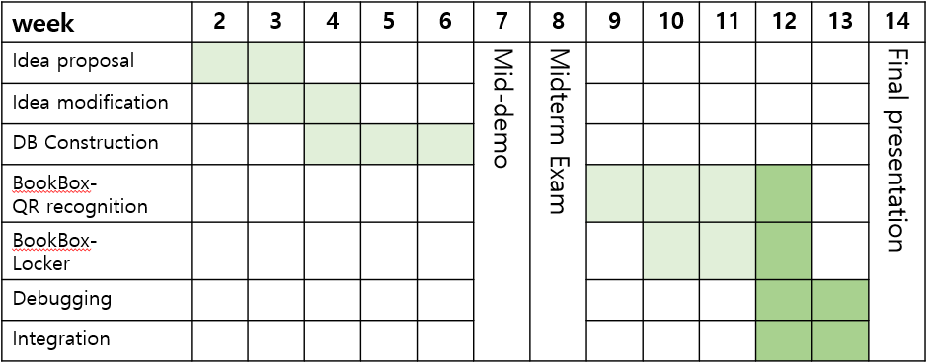
Hoyun Ko
Yuseon Nam
Seungyun Lee

Slide 30
Q&A

